Slide 1
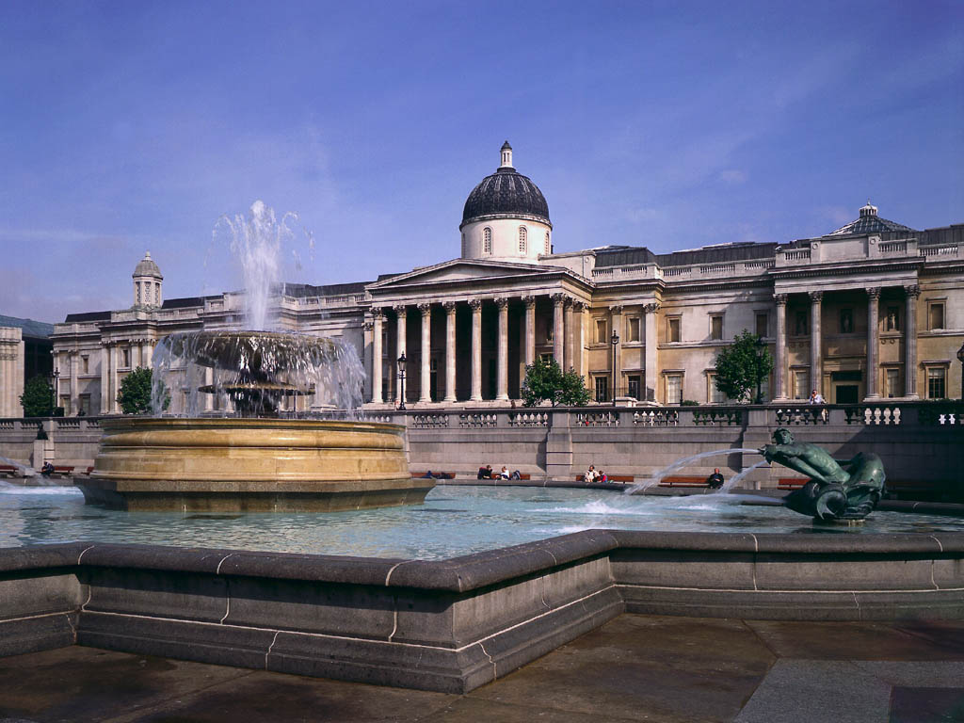
National gallery

Slide 2
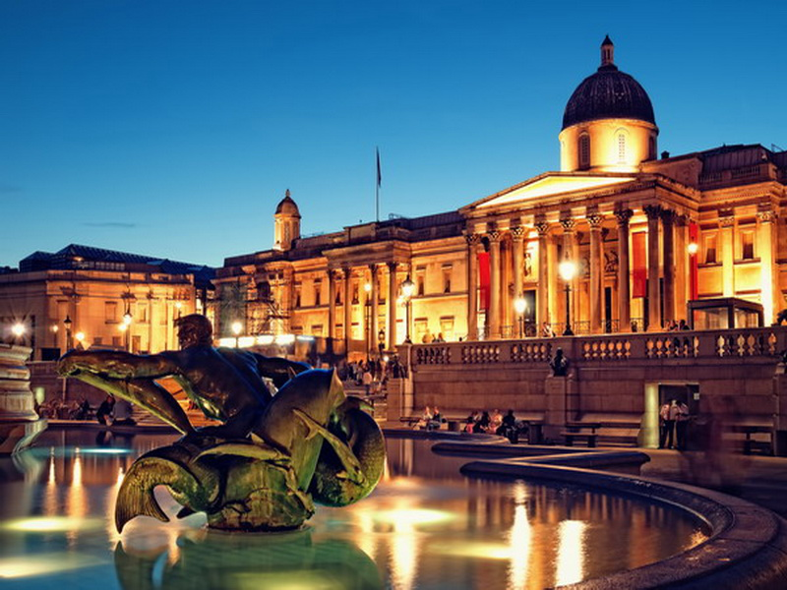
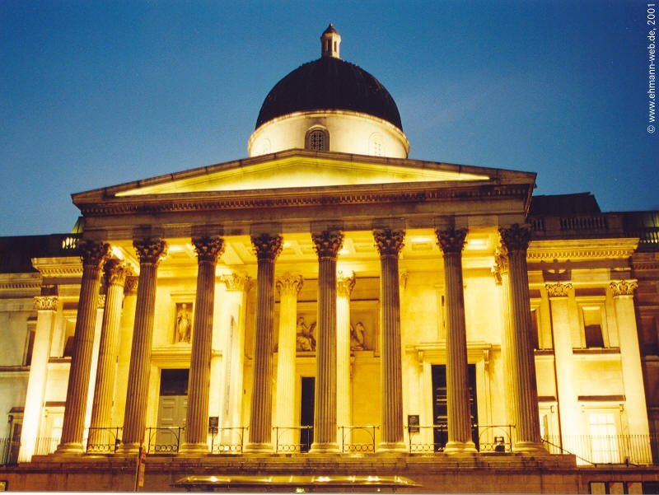
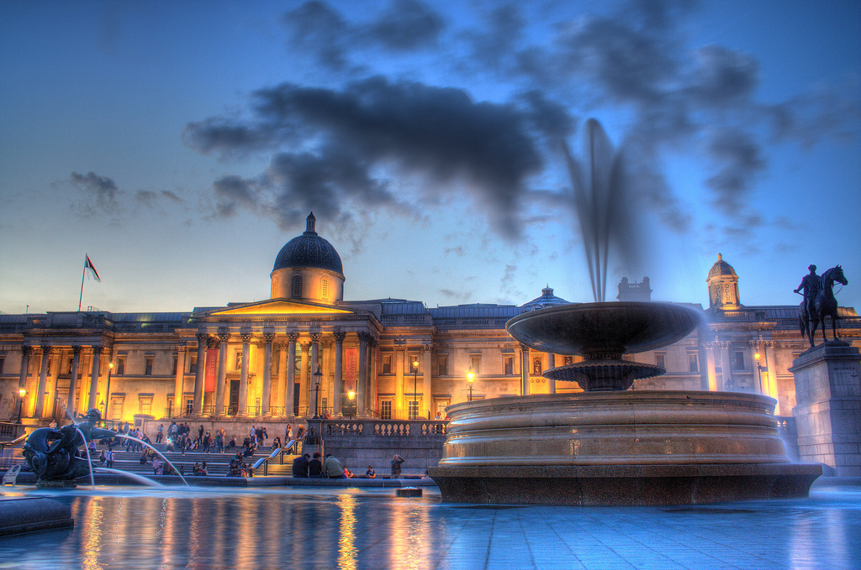

Slide 3
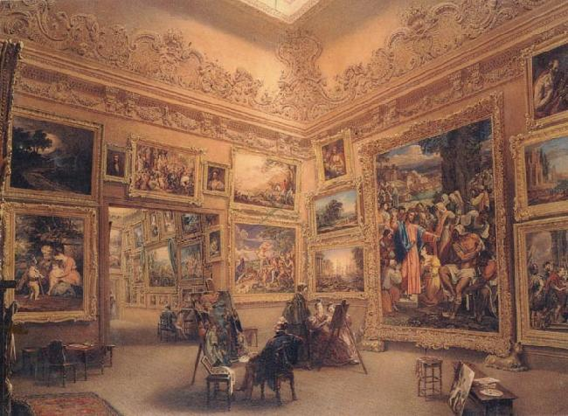
How it all started
The National Gallery is an art museum in Trafalgar Square in the City of Westminster, in Central London. Founded in 1824, it houses a collection of over 2,300 paintings dating from the mid-13th century to 1900.
Unlike comparable museums in continental Europe, the National Gallery was not formed by nationalizing an existing royal or princely art collection. It came into being when the British government bought 38 paintings from the heirs of John Julius Angerstein, an insurance broker and patron of the arts, in 1824. After that initial purchase the Gallery was shaped mainly by its early directors, notably Sir Charles Lock Eastlake, and by private donations, which comprise two-thirds of the collection.

Slide 4
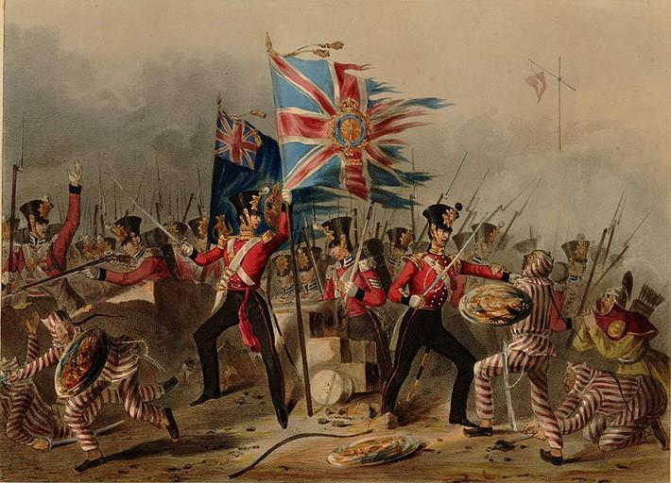
What was going on in England at the time?
London at that time was the last of the European capitals, which did not have an art Museum open to the General public.
The history of great Britain of the 19th century is full of both negative and positive phenomena. Negative developments include an increase in the number of unemployed army soldiers returning home after the wars with Napoleon. In addition, the industry that supplied all types of ammunition, weapons, and food to the army, experienced a sharp decline in production since the end of these wars. All this led to an increase of crime in the UK in the 19th century. In the state, a change in domestic policy was required, and it occurred. The political forces of great Britain, radicals and liberals, found a common language. In 1832 a law, which limited the role and power of the king, appeared. In addition to the reform, there was significant growth of the middle class, which included priests, layers, doctors and other professions.

Slide 5
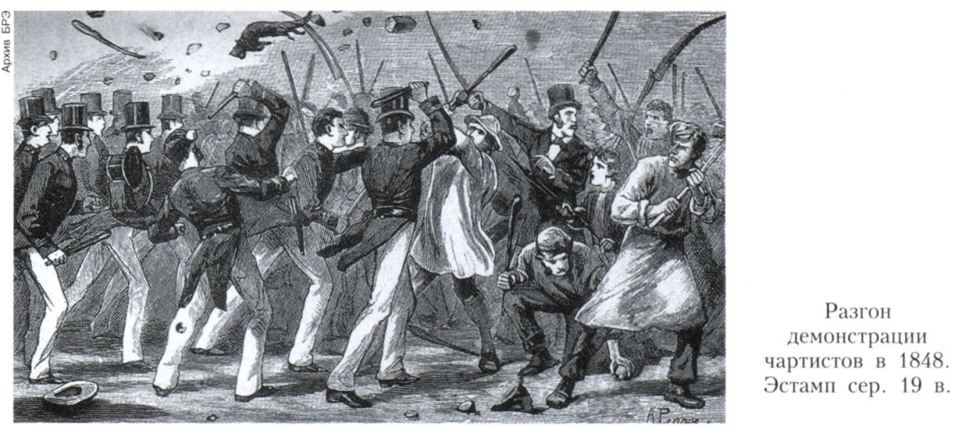
Conclusion
From this we conclude that England during the opening of the gallery was subjected to uprisings and failures

Slide 6
What happened to the gallery during this time?
The Gallery started to attract visitors of different types and classes. Its location in Trafalgar Square was significant, as the Gallery was situated between the wealthy West End and poorer areas to the east. So, the collection could be accessed by people of all social classes. The gallery moved several times. For the first 13 years it was located in the district of Westminster. During that period, the collection increased from 57 to 208 works, and the number of visitors went up from 5300 to 30500. In 1885 there was a fire, so the Gallery had to move once again.
15th- and 16th-century Italian paintings were at the core of the National Gallery for the first 30 years of its existence. The collection consisted of works by High Renaissance masters.
But its new director, Sir Charles Lock Eastlake, who was the President of the Royal Academy, knew most of London's leading art experts.
The new director’s taste was for the Northern and Early Italian Renaissance masters or "primitives". One of the famous masterpieces of that time is “The Baptism of Christ” by Piero della Francesca.
Another significant step in the development of the Gallery belonged to The Pre-Raphaelite Brotherhood. Later on known as “The Pre-Raphaelites”, it was founded in 1848. The group continued to accept the concepts of history painting and imitation of nature, as central to the purpose of art. The Pre-Raphaelites defined themselves as a reform movement, created a distinct name for their form of art, trying to avoid the routine.

Slide 7
At that time in England
There was the third electoral reform of 1884-1885. In the last quarter of the nineteenth century in England, a series of laws that further democratization of the electoral law, were established. It made possible the introduction of electoral districts with equal representation from the same population (one member from 50-54 thousand inhabitants).
In the middle of the 19th century Britain was the richest and most powerful nation in the world. However in the late 19th century Britain's power declined. Britain was the first country to industrialize. She therefore had a head start over other nations. However the other countries began to catch up. France, Germany and the USA industrialized. By the end of the 19th century Russia, Sweden, (North) Italy and Japan were also industrializing. As a result Britain became relatively less important. By the end of the 19th century it was obvious that Britain was no longer as powerful as it had once been.

Slide 8
conclusion
The national gallery has been subjected to many innovations, while in England there have been political changes.

Slide 9
The national gallery in the 20th century
In the beginning of the 20th century the gallery received new masterpieces as the agricultural crisis caused many aristocratic families to sell their paintings.
Nevertheless, the National Gallery happened to suffer from the political protests. As an example, “the Rokeby Venus” was damaged on 10 March 1914 by Mary Richardson, in protest against the arrest of her colleague the previous day. Later that month another member f the movement attacked five Bellinis.
The Gallery had to close until the start of the First World War, when the Women's Social and Political Union called for an end to violent acts.
Shortly before the outbreak of World War II the paintings were evacuated to various locations in Wales.
There were even discussions about moving the paintings to Canada. This idea was firmly rejected by Winston Churchill, who wrote in a telegram to the director: “Bury them in caves or in cellars, but not a picture shall leave these islands”.
The first catalogues on the collection appeared during the evacuation which improved the whole system of exhibiting paintings of the gallery.
The paintings returned to Trafalgar Square in 1945.
In the post-war years, the prices for Old Masters – and even more so for the Impressionists and Post-impressionists – have risen beyond its means. Some of the Gallery's most significant paintings such as “The Virgin and Child with St. Anne” and “St. John the Baptist by Leonardo da Vinci” were bought in 1962 with the help of donations.
Since 1989, the gallery has run a scheme that gives a studio to contemporary artists to create work based on the permanent collection.

Slide 10
the country in the 20th century
In the twentieth century Britain was a rich and powerful country. The majority of its revenues came from its colonies overseas . British financial and insurance companies were doing business in all parts of the world, British money was invested in the economies of other countries, bringing huge dividends to their owners.
However, at this time there was a serious lag of the British industry. The technical base of production in Britain was outdated, and the modernization of the industry was being carried out very slowly.
At the same time, the period of king Edward VII (1841-1910), was marked by a huge number of technical innovations, such as telephones, gramophones and other devices.
We can also mention the agricultural crisis that turned a great number of wealthy people into poverty and misery.
Between 1901 and 1910 the country was run by a combination of the aristocracy with the richest manufacturers and bankers. In the first decades of the 20th century, Britain was not a democracy, in that half the adult population had no vote.
All these reasons led to political unrest and different kinds of protests. Groups of rebels such as feminists, anarchists started to appear and develop.
The first world war made a negative impact on British economy.
Later on, with the development of the country, new tendencies in arts, culture and literature appeared which created a new type of the society.

Slide 11
21st century
In the 21st century there have been three large fundraising campaigns at the Gallery: in 2004, to buy Raphael’s Madonna of the Pinks, in 2008, for Titian's Diana and Actaeon, and in 2012, Titian's Diana and Callisto.
In 2014, the National Gallery was the subject of a documentary film by Frederick Wiseman. The film shows the gallery administration and staff at work, the conservation laboratory, docent tours, and the mounting of Leonardo Da Vinci, J. M. W. Turner, and Titian exhibitions in 2011–2012.

Slide 12
21st century in England
The UK is one of the leading countries in the world with strong economy and power.
That gives Britain the opportunity for developing its social, industrial and cultural level.

Slide 13
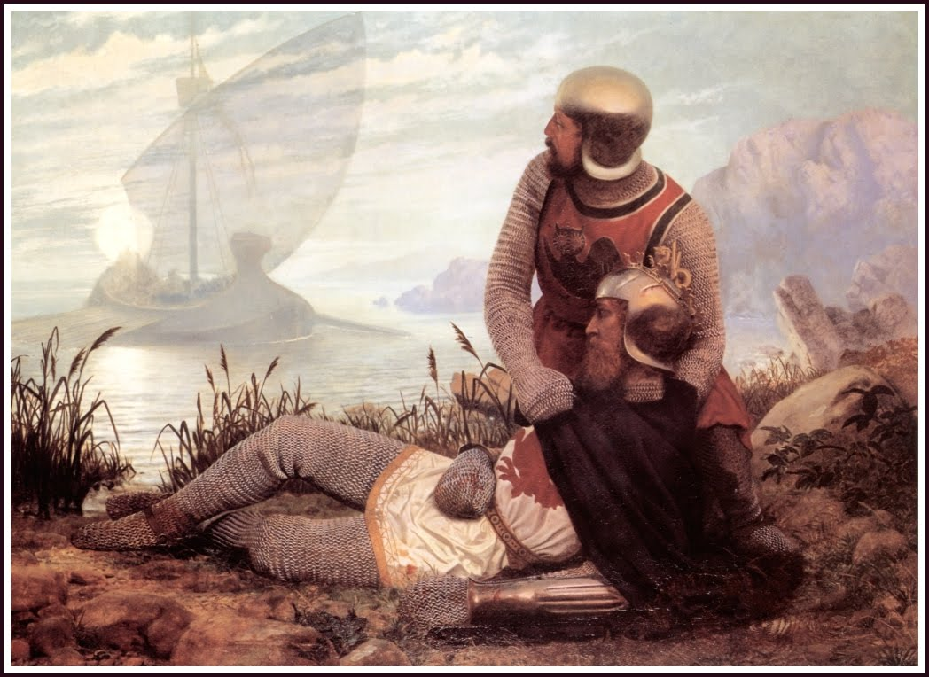
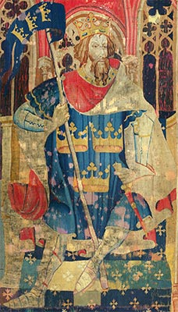
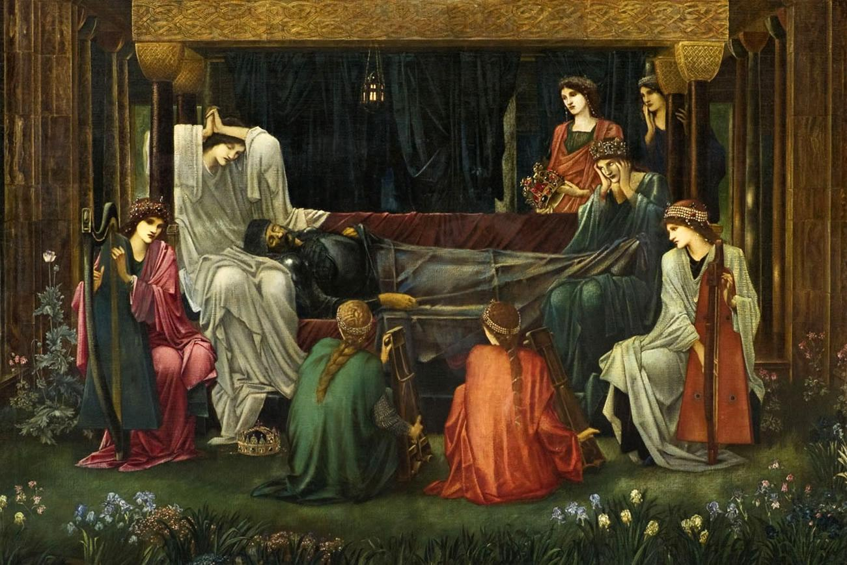

Slide 14
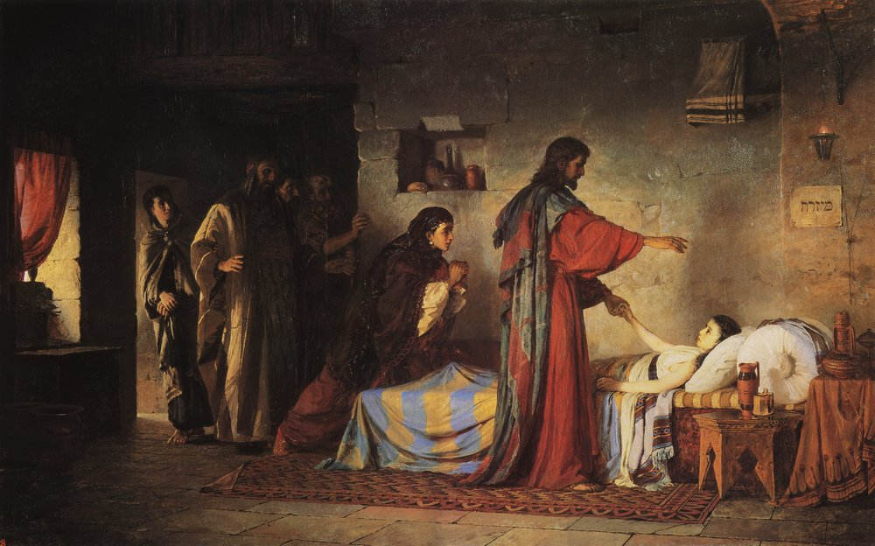
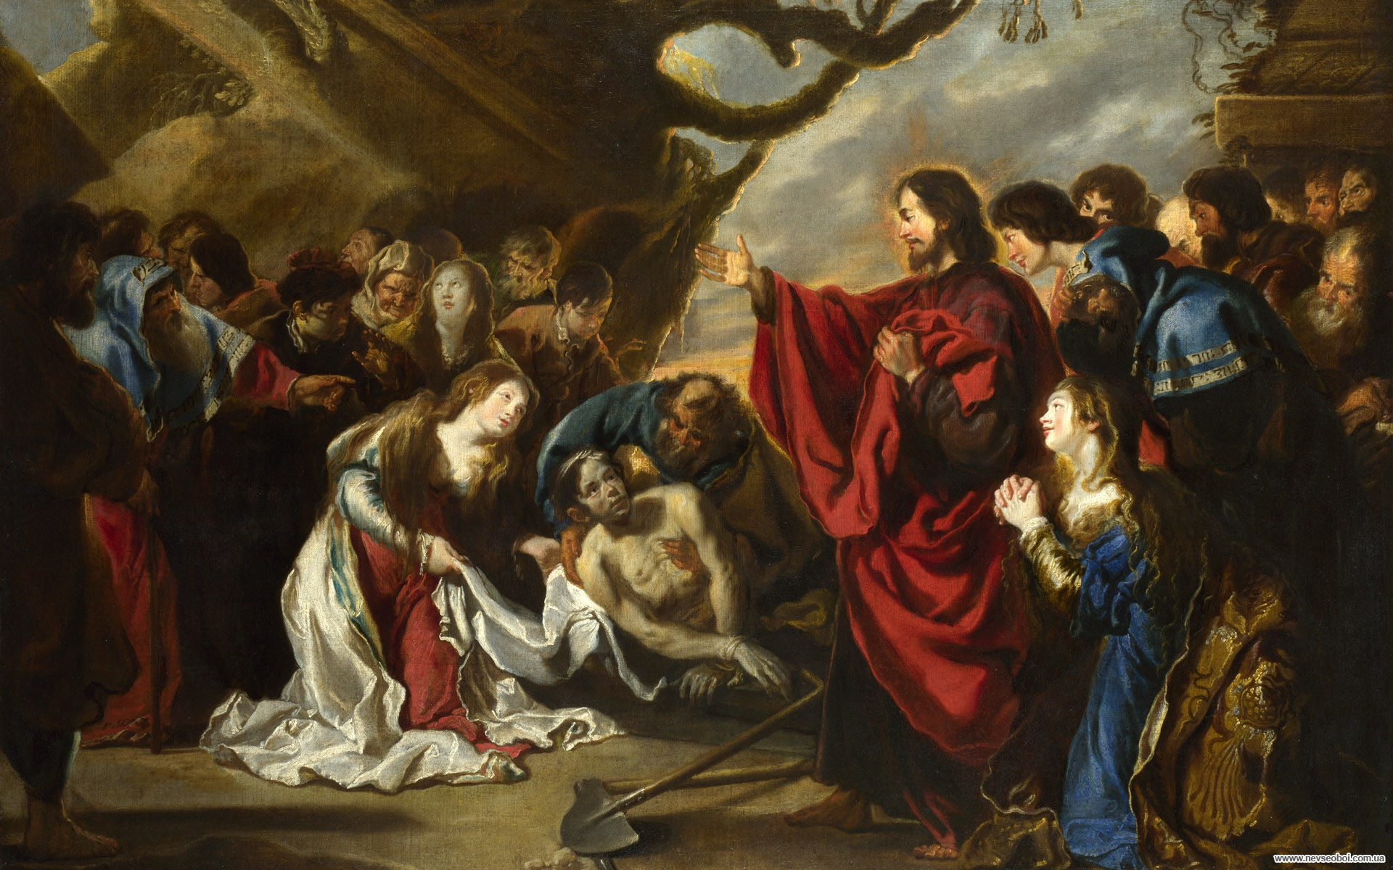
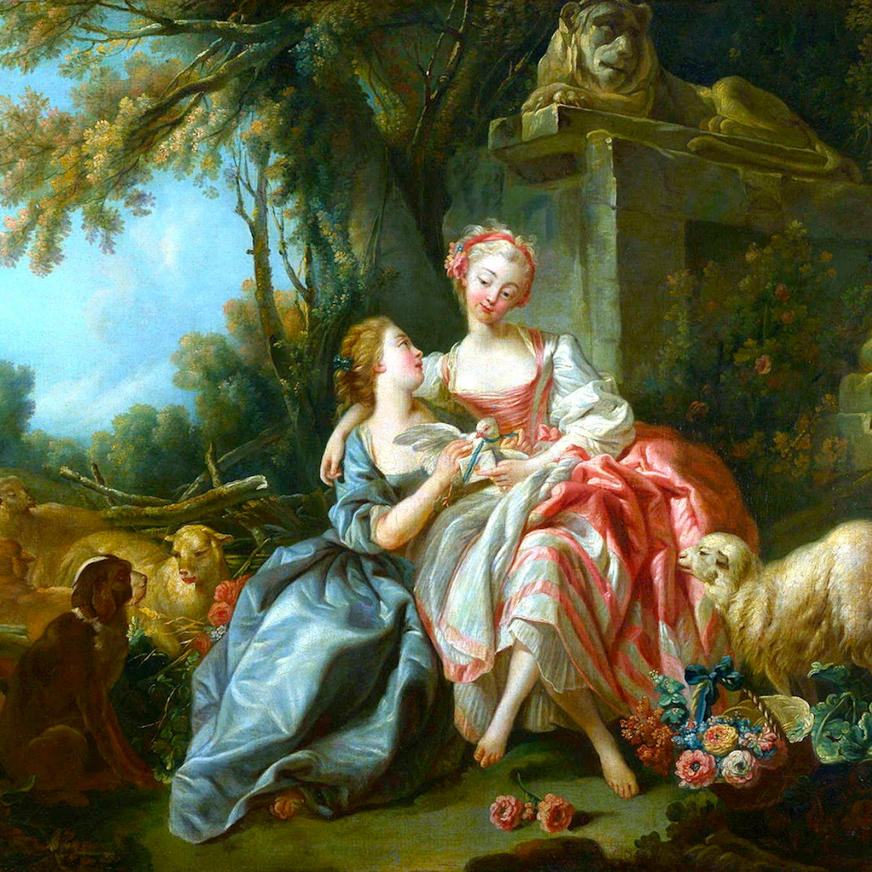
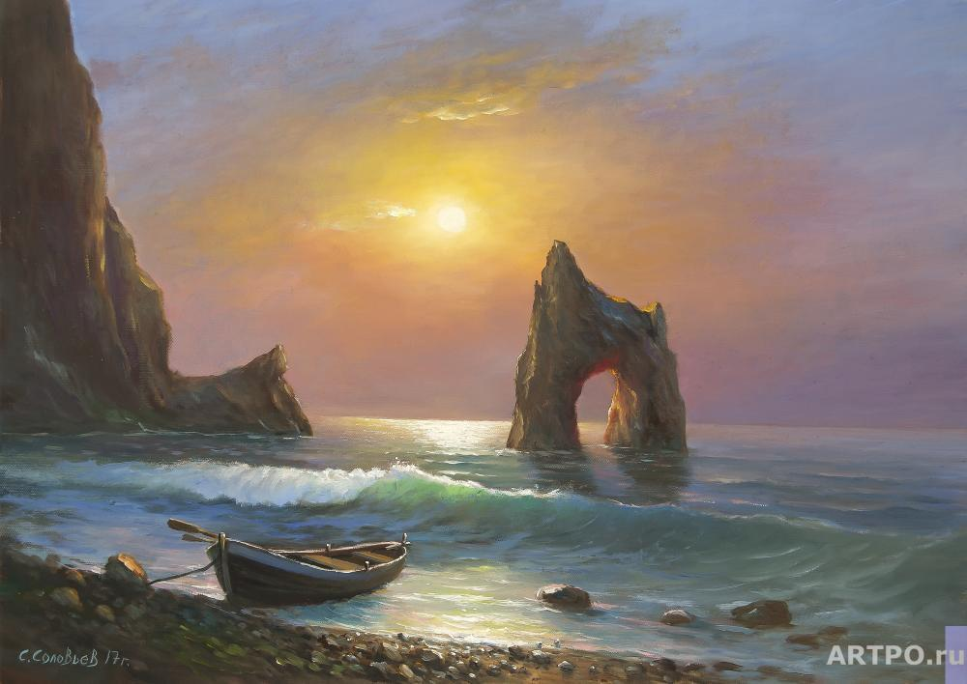
pictures National Gallery

